Slide 1
Split the mask to left or right side only

Slide 2
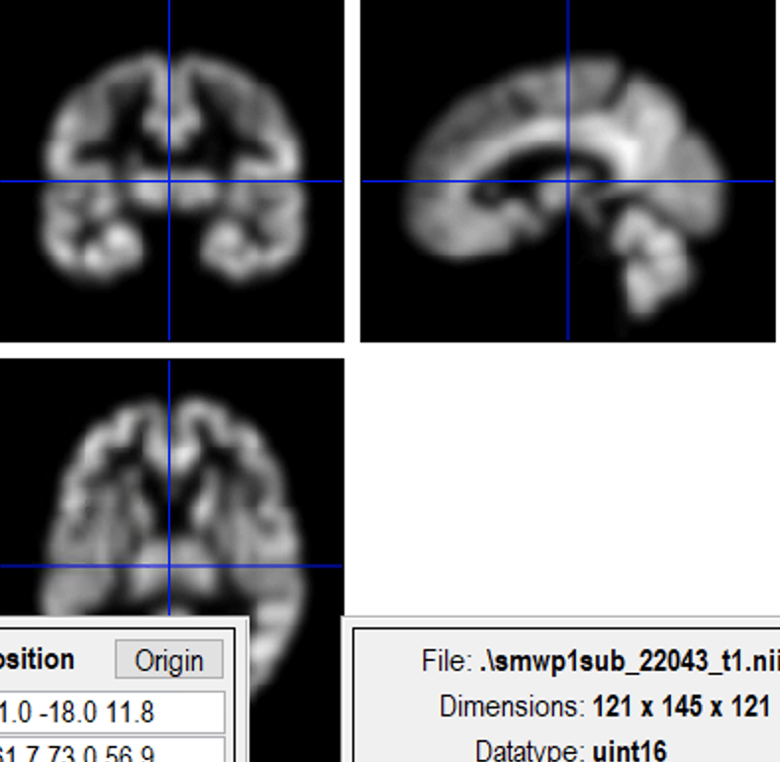
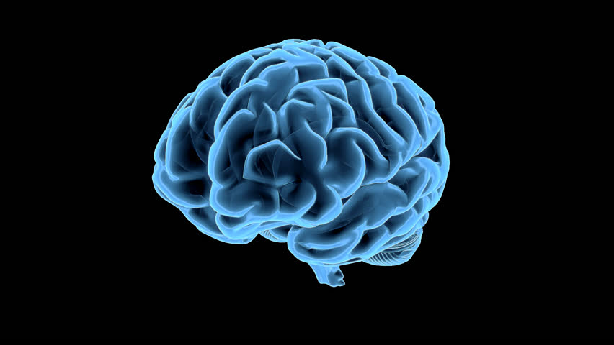
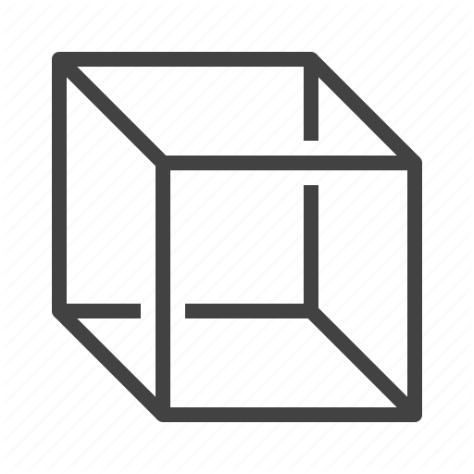
L
X
R
y
z
z
X= (range+1)/2
face
y
x
Right-left (looking from back, so actually looking from front 0=left): 0-121
Back-front: 0-145
Bottom-upper: 0-121

Slide 3
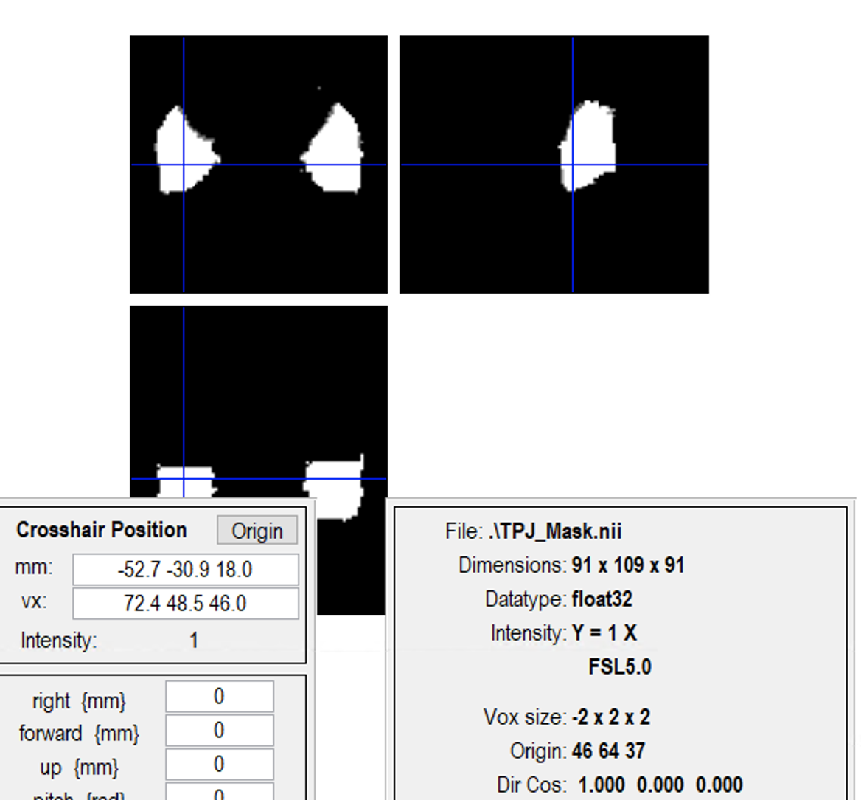
(91+1)/2=46
Left: 46-91
Origin: 46
Right: 0-45

Slide 4
Take careful. The original Data is overwritten!!! So you need make the other side, you need to renew your TPJ_Mask.nii

